Slide 1





WHEELEASE
Home
About
Service
Contact
Shop Now
Wheel-Ease
A Two-Wheeler Purchase, Rental & Accessories eCommerce Platform

Slide 2

WHEELEASE
Home
About
Service
Contact
Shop Now
Full Stack Engineering (22CS037)
Submitted By:
Prachi Singla(2210990662)
Pratistha Negi (2210990678),
Prerna Dua (2210990680),
Punal (2210990690)
02
Semester: 6 (2025-2026)

Slide 3



WHEELEASE
Home
About
Service
Contact
Shop Now
Problem Statement
The two-wheeler industry lacks a unified platform for buying, renting, and purchasing accessories.
Challenges:
High costs of new two-wheelers.
Limited access to short-term rentals.
Scattered accessory marketplaces.
Read More
That all aspects of motorcycle safety, such as brakes, tires, and steering systems.
03

Slide 4
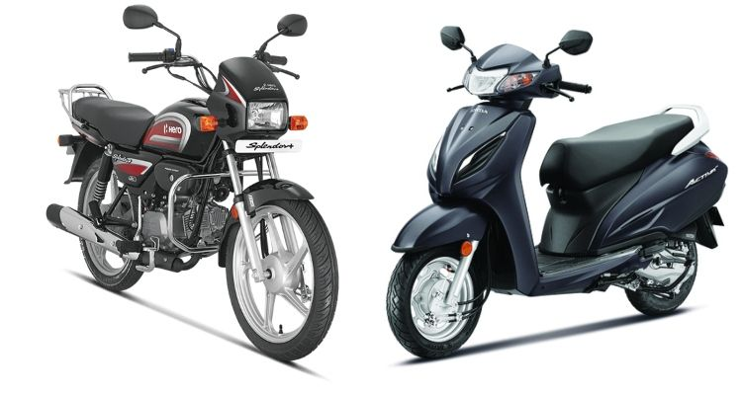
WHEELEASE
Home
About
Service
Contact
Shop Now
Objective
Develop an online marketplace to buy, rent two-wheelers, and purchase accessories
04

Slide 5
WHEELEASE
Home
About
Service
Contact
Shop Now
KEY LEARNINGS
Understanding consumer demand.
Developing intuitive UI/UX.
Implementing secure transactions.
Integrating logistics & delivery management.
05

Slide 6
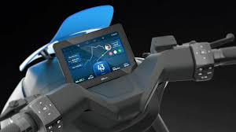
WHEELEASE
Home
About
Service
Contact
Shop Now
Tech Stack Choices
Frontend: React.js / Next.js (Web), React Native / Flutter (Mobile App)
Backend: Node.js with Express.js (REST API)
Database: MongoDB / PostgreSQL
06

Slide 7
WHEELEASE
Home
About
Service
Contact
Shop Now
Advantages / Disadvantages
Aspect | Advantages | Disadvantages
Integrated Platform | Single platform | Higher development complexity
Flexible Rentals | Short-term & long-term plans | Risk of damages & theft
AI-Powered Suggestions | Personalized recommendations | Data privacy concerns
KYC & Digital Payments | Secure & fast verification | Compliance with financial laws
Subscription Model | Recurring revenue generation | Requires strong customer retention
07

Slide 8
WHEELEASE
Home
About
Service
Contact
Shop Now
REFRENCES
Market analysis of two-wheeler eCommerce & rental services
Competitor platforms like Bounce, Royal Enfield Rentals, Amazon (Accessories)
Documentation on MERN Stack, Payment Gateways, KYC APIs, and Logistics Management Systems
08

Slide 9






WHEELEASE
Home
About
Service
Contact
Shop Now
Contact Details
Phone Number
Website
+91 9854176952
www.wheelease@gmail.com
Social Media
Address
@wheelease
sector 20, Chandigarh
09

Slide 10


WHEELEASE
Home
About
Service
Contact
Shop Now
Thank You
We are always ready to help you with your problematic vehicle.

